Slide 1
PrEP is not just a pill, but a comprehensive service for sex workers.
Yogan Pillay
National Department of Health: South Africa
23 July 2018, IAS 2018

Slide 2
WHO GUIDANCE 2015
Universal Test and Treatment (UTT):
    ART should be initiated in everyone living with HIV regardless of their CD4 cell count.
Pre-Exposure Prophylaxis (PrEP):
    People with a substantial risk of HIV infection should be provided with daily PrEP as part of a combined HIV prevention strategy.

Slide 3
Oral PrEP and UTT guidelines
From policy to phased implementation
Preparation
March –May 2016
Site assessment & readiness
Training & implementation tools (SOPs, M&E reporting forms)
Approved
March 2016
Drug supply
Policy
October 2015 – March 2016
Phased Implementation
June 2016-to-date
Sex workers at selected sites
1 June 2016
Youth at select university campus clinics
1 October 2017
MSM at selected sites
1 April 2017
Social mobilization and demand creation
IEC materials & job aids
AGYW at selected public clinics
April 2018

Slide 4
Objectives of the PrEP &
Test & Treat Policy
PrEP offered as an addition in the context of combination prevention
Increase access to health services including HIV treatment
Integrate PrEP and T&T into HIV prevention programmes, policies, and services
Provide PrEP and T&T within the broader framework of quality health service provision
Implement evidence-informed communication and advocacy strategies

Slide 5
National Strategic Plan HIV, STI & TB
Populations to focus on
Adolescent girls (15-19)
Young women (20-24)
Sex Workers
Men who have sex with men (MSM)
Intravenous Drug Users (IDU)

Slide 6
PrEP offer and Sex Workers

Slide 7
South African National
Sex Worker HIV Plan 2016-2019
Goal
To achieve a long and healthy life for all sex workers, their clients, non-commercial sex partners and children.
Aims
Reduce HIV, STI and TB incidence among sex workers;
Reduce HIV, STI and TB-related mortality among sex workers; and
Reduce human rights violations experienced by sex workers.

Slide 8
Sex Worker Plan 2016-2019
To reach 70 000 sex workers with a core package of services
To recruit 1 000 peer educators
To ensure that 95% of sex workers use condoms with their clients
To provide PrEP for at least 3 000 sex workers (this target will be reviewed once the uptake is assessed in the first year)
To ensure that 90% of sex workers reached are tested for HIV and know their status
To ensure that 90% of sex workers who test positive are on ART
To ensure that 90% of sex workers on ART are virally suppressed
To reduce instances of violence against sex workers by 50%

Slide 9
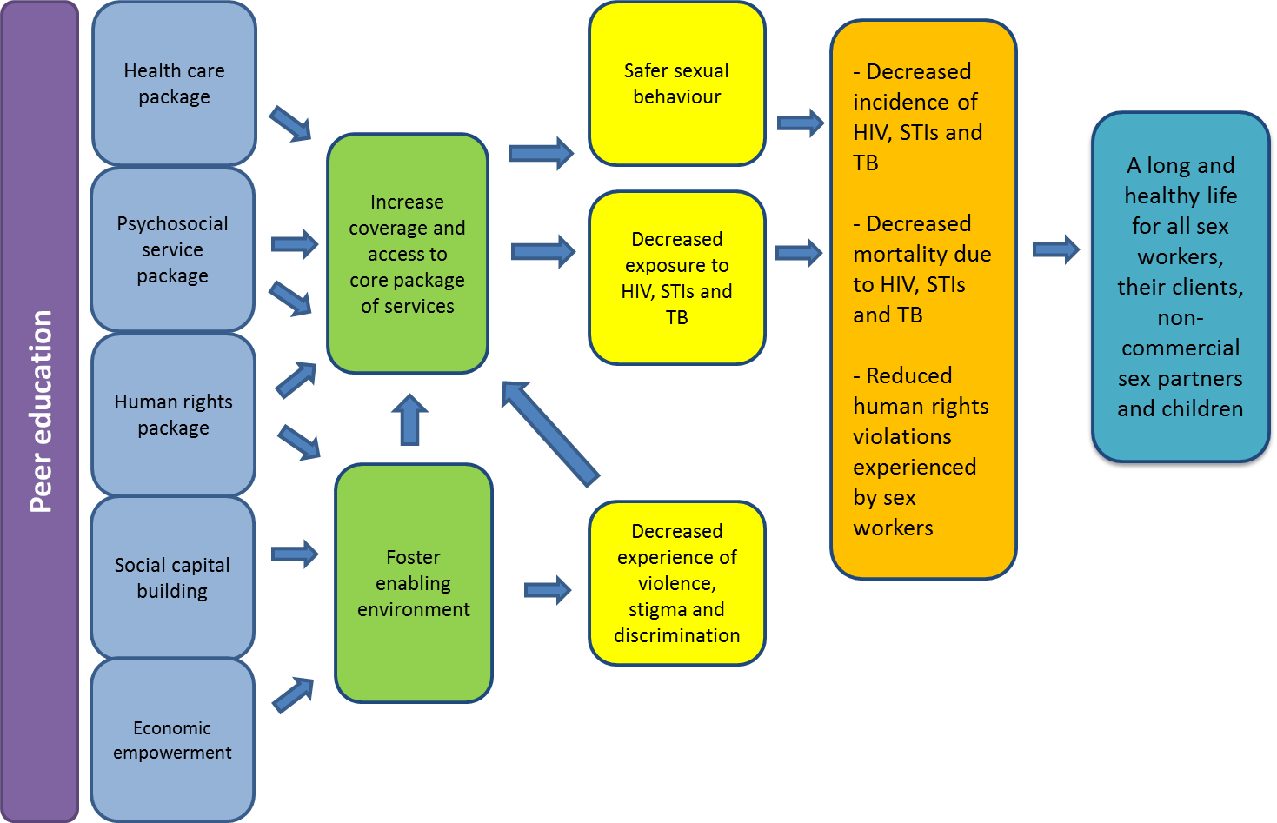
Theory of Change
(Sex Worker Plan)

Slide 10
Implementation Process
Comprehensive Package of HIV Prevention & Treatment Interventions
Package of Interventions Sex Workers
Designated Services In Partnership -NGO, Government & Donors
(fixed, mobile, outreach)

Slide 11
Implementation Process
Audit of potential service delivery sites
National level support provided for PrEP implementation
    Training
        Clinicians (NIMMART trained nurses)
        Lay Counsellors (Testing)
        Peer educators (Education & social mobilisation)
        M & E officers (Data management)
    Monitoring & evaluation
    IEC and promotional material
    PrEP drugs procured and distributed centrally

Slide 12
Package of Interventions Sex Workers
Designated Services In Partnership -NGO, Government & Donors
(fixed, mobile, outreach)
Outreach
Peer Lead education and social mobilisation
Pre & post test counselling
SRH & PHC
STI & TB screening & treatment
Combination Prevention
Psychosocial support
Treatment
Outreach
Linkage to care
Contraception
PAP smears
Emergency contraception
CTOP
Risk reduction counselling
Condoms (male & female) & lubricants
PEP
PrEP
Test and treat
Treatment adherence support
Viral loads
Linkage to care
Counselling
Post trauma care & counselling
Creative spaces
HIV Testing
3 monthly

Slide 13
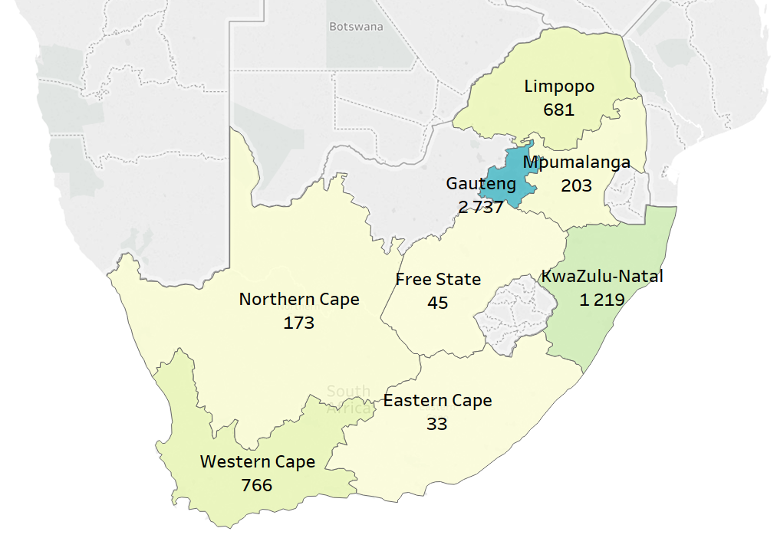
Oral PrEP Initiations
June 2016 – May 2018
From
June 2016 –
May 2018
5 857
initiations
Took place at
34 SITES
across South Africa
        Provincial coverage includes:
        GAUTENG
        FREE STATE
        EASTERN CAPE
        KWAZULU-NATAL
        LIMPOPO MPUMALANGA NORTHERN CAPE
        WESTERN CAPE
Oral PrEP initiations by province
June 2016 – May 2018

Slide 14
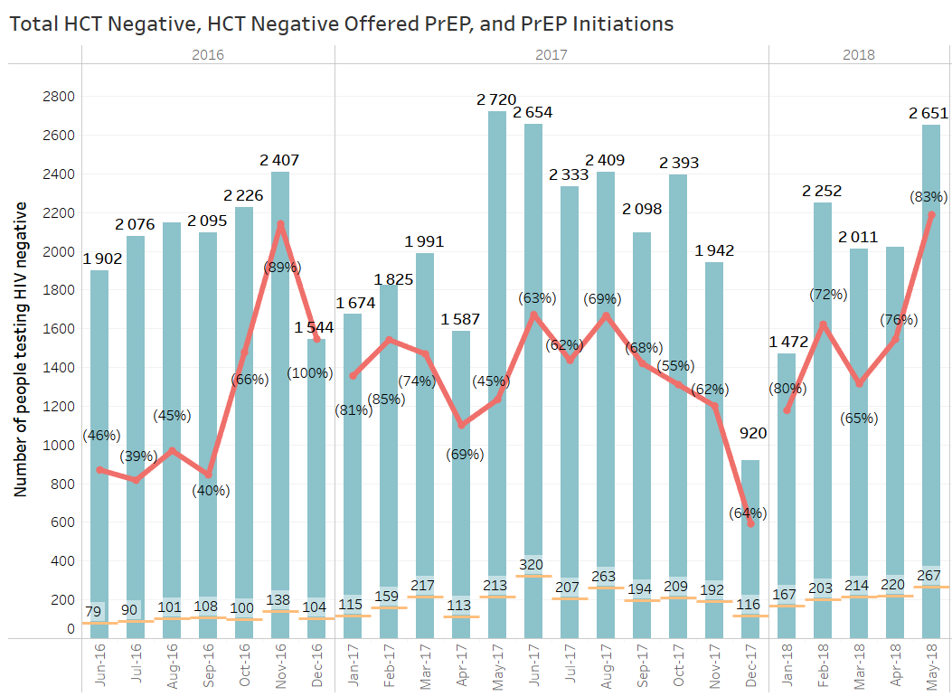

Oral PrEP Implementation
Oral PrEP and ART commencements at Sex Worker sites

Slide 15
Oral PrEP Implementation: testing to initiation
49 352 (87%)
32 537 (66%)
4 109 (13%)
June 2016 –
May 2018
SW sites
56 475
Neg. HIV tests
# offered PrEP
PrEP initiations
Total HIV tests conducted at implementing SW sites
7 123 (13%)
3 666 (51%)
Pos. HIV tests
ART initiations

Slide 16
PrEP unit cost (2017 ZAR)
 | Young women (20-24) | Female adolescents (15-19) | FSW | Young Men (20-24) | Male adolescents (15-19) | MSM
First year | 1,918 | 1,915 | 1,939 | 1,900 | 1,900 | 1,890
Follow-up | 1,647 | 1,647 | 1,637 | 1,631 | 1,631 | 1,621
PrEP cost per patient year is R1,621-R1,939
Cost varies between populations by ~6% and between first and follow-up years ~16%

Slide 17
Oral PrEP Implementation for
Key and Vulnerable Populations
Oral PrEP fits easily into combination prevention and SRH services
Non-judgemental, non-stigmatising attitudes from clinic staff members is critical, especially for adolescents and young people
Outreach is key in reaching target population, and equally important for follow-up
Uptake of Mobile services is higher than fixed clinics
Flexibility in clinic hours greatly increases uptake
Peer-led programmes result in higher demand creation and uptake
Clear, regular communication is important
Special attention to client needs in first 30 days of PrEP use is critical
  Side effects
  Adherence
  Psychosocial support
Lessons learned

Slide 18
Oral PrEP Implementation for
Key and Vulnerable Populations
A professional nurse trained to initiate ART and deliver sexual reproductive health services, a counsellor and a peer educator are the basic staff required
Expansion of PrEP to public facilities will require special attention to staff attitudes and responsiveness to key and vulnerable populations
Support for retention on PrEP and ART especially side-effect management is critical
Tracking and tracing clients who fail to return requires special attention
Lessons learned

Slide 19
Oral PrEP Implementation for
Key and Vulnerable Populations
PrEP can only be delivered from a health facility that meets the regulatory criteria to keep and dispense scheduled medication.
Making PrEP available to key and vulnerable populations who already have limited access to health services
Limited number of health facilities that are sensitive to the needs of key populations and adolescents and youth
Promoting and marketing a new HIV prevention intervention amongst sex workers and transgender who already feel marginalised and discriminated against
The experience of side effects from PrEP drugs
Low uptake and retention of PrEP amongst sex workers
Challenges

Slide 20
Thank you!

